Slide 1
Introduction to machine learning

Slide 2

agenda
Introduction to ML
What can we do using Machine Learning
Common ML Libraries
Pytorch vs Tensorflow

Slide 3

What is machine learning?

Slide 4

Machine Learning
Machine learning is a subset of artificial intelligence. It’s a branch of AI that focuses on creating systems that can learn from data and improve their performance over time
It enables systems to learn from data without explicit programming.
Common applications include image recognition and natural language processing
Machine learning algorithms can be categorized into supervised, unsupervised, and reinforcement learning.
Notes:
This slide introduces machine learning as an essential concept in AI. Emphasize how machine learning allows systems to learn from data autonomously. Discuss the various applications and types of algorithms, as it is critical to understand their significance in the evolving tech landscape.

Slide 5
Applications of machine learning

Slide 6
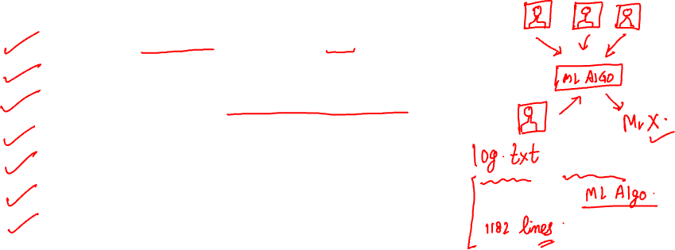
What can we do using Machine Learning?
Give your homemade robot a brain — make it recognize faces or learn to walk!
Unlock hidden patterns in your company’s user logs, financial reports, and sensor data.
Segment customers to design smarter, personalized marketing strategies.
Recommend products to users by learning from similar customer behavior.
Detect potentially fraudulent transactions automatically.
Forecast sales, revenue, or demand with data-driven predictions.
Automate and optimize real-world decisions using intelligent algorithms.
Notes:
Machine learning opens up new possibilities for innovation. By harnessing data, you can empower your projects and make informed decisions. This slide outlines the various applications of machine learning, from enhancing robotic capabilities to analyzing customer data for targeted marketing. Embrace this technology to unlock hidden insights and drive your projects forward.

Slide 7
Common ml libraries

Slide 8
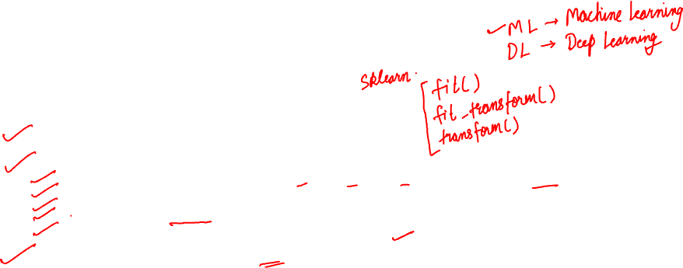
Common Machine Learning Libraries
Let’s look at the most popular tools used in Machine Learning today.
Here are the libraries you will use as a Data Scientist/ML Engineer:
Scikit-Learn – Best for beginners and is used for regression/classification/clustering. Includes ready to use algos
TensorFlow – Built by Google for large scale ML
Keras – Contains high level APIs for deep learning. Comes built in with tensorflow
PyTorch – Developed by Facebook
Pandas / NumPy (for data handling) – Coz before ML you need clean data
If you are just starting out with deep learning, Keras is your best bet
Notes:
Machine learning opens up new possibilities for innovation. By harnessing data, you can empower your projects and make informed decisions. This slide outlines the various applications of machine learning, from enhancing robotic capabilities to analyzing customer data for targeted marketing. Embrace this technology to unlock hidden insights and drive your projects forward.

Slide 9
Pytorch vs tensorflow

Slide 10

Pytorch vs tensorflow
Scenario | Recommendation
You're just starting out | Keras (with TensorFlow)
You want control for custom models | PyTorch
You’re working in a research lab | PyTorch
You want to deploy to mobile/web | TensorFlow

Slide 11
Thank you

